Slide 1
Transformer and Multi-head attention

Slide 2
1. Dataset
Small synthetic dataset for sentiment classification
Examples:
"I love this movie" → Positive
"This is amazing" → Positive
"I hate this" → Negative
"This is bad" → Negative
Total samples: ~150–160
texts = [
"i love this movie", "this is amazing", "i like it", "so good",
"i hate this", "this is bad", "terrible experience", "not good"
] * 20 # total ~160 samples
labels = [1,1,1,1,0,0,0,0] * 20

Slide 3
2. Tokenization
vocab_size = 1000
max_len = 10
vectorizer = layers.TextVectorization(
max_tokens=vocab_size,
output_mode="int",
output_sequence_length=max_len
)
vectorizer.adapt(texts)
X = vectorizer(np.array(texts))
y = np.array(labels)

Slide 4
3. Positional Encoding Layer
class PositionalEmbedding(layers.Layer):
def __init__(self, max_len, vocab_size, embed_dim):
super().__init__()
self.token_emb = layers.Embedding(vocab_size, embed_dim)
self.pos_emb = layers.Embedding(input_dim=max_len, output_dim=embed_dim)
def call(self, x):
positions = tf.range(start=0, limit=tf.shape(x)[-1], delta=1)
return self.token_emb(x) + self.pos_emb(positions)

Slide 5
4. Transformer Block
class TransformerBlock(layers.Layer):
def __init__(self, embed_dim, num_heads, ff_dim):
super().__init__()
self.att = layers.MultiHeadAttention(num_heads=num_heads, key_dim=embed_dim)
self.ffn = keras.Sequential([
layers.Dense(ff_dim, activation="relu"),
layers.Dense(embed_dim),
])
self.norm1 = layers.LayerNormalization()
self.norm2 = layers.LayerNormalization()
def call(self, inputs):
attn_output = self.att(inputs, inputs)
out1 = self.norm1(inputs + attn_output)
ffn_output = self.ffn(out1)
return self.norm2(out1 + ffn_output)

Slide 6
5. Build Model
inputs = layers.Input(shape=(max_len,))
Parameter:
embed_dim = 32
num_heads = 2
ff_dim = 32
Steps: Positional Embedding -> Transformer Block -> Global Average Pooling 1D -> Dense(activation="relu") -> Dense(activation="sigmoid")

Slide 7
6. Compile & Train
optimizer="adam",
loss="binary_crossentropy",
metrics=["accuracy"]
epochs=10,
batch_size=8,
validation_split=0.2
Plot Accuracy and loss curve

Slide 8

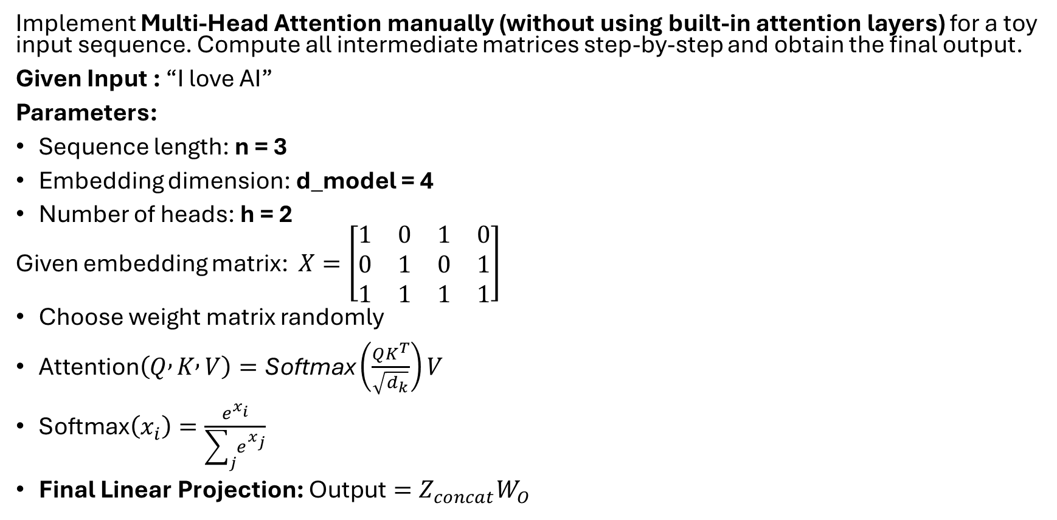
Assignment
Implement Multi-Head Attention manually (without using built-in attention layers) for a toy input sequence. Compute all intermediate matrices step-by-step and obtain the final output.
Given Input : “I love AI”
Parameters:
Sequence length: n = 3
Embedding dimension: d_model = 4
Number of heads: h = 2
Given embedding matrix: $X=\left[\begin{matrix}1 & 0 & 1 & 0 \\ 0 & 1 & 0 & 1 \\ 1 & 1 & 1 & 1\end{matrix}\right]$
Choose weight matrix randomly
$\text{Attention}\left(Q , K , V\right)=\text{Softmax}\left(\frac{QK^{T}}{\sqrt{d_{k}}}\right)V$
$\text{Softmax}\left(x_{i}\right)=\frac{e^{x_{i}}}{\sum_{j}{e^{x_{j}}}}$
Final Linear Projection: $\text{Output}=Z_{concat}W_{O}$
Expected Output
Compute all intermediate matrices:
$Q,K,V$
Attention scores
Softmax matrix
Head outputs
Final output matrix after projection

